Slide 1
Southern Water Corp
Problem: The reliability of the desalination plant (asset) is critical because if the asset fails, then the asset will no longer generate revenue and will contribute to increased maintenance costs
Building a solution: To increase reliability of the asset, the first step is to identify what variables may indicate when a pump may be failing
Must determine variables that fluctuate in response to a pump failure event
Surjek is the location of four major desalination plants which have showed signs of being at risk of failure so it will be the basis of this analysis
Full problem statement found here

Slide 2

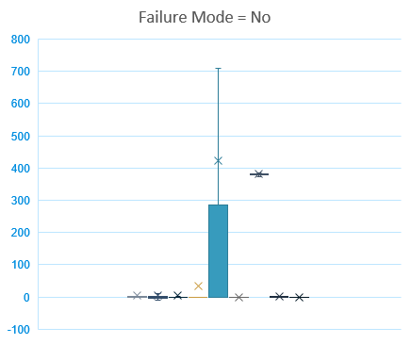
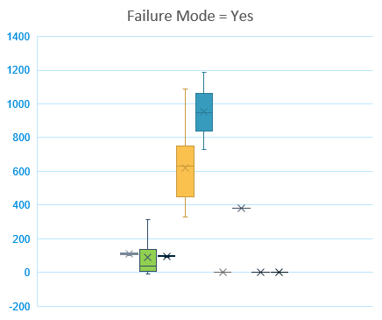
Failure Mode Analysis
Failure Mode Yes vs. No; outliers removed
When the failure mode equals yes, the median of flow meter 2, pump torque, and maximum pump torque increase compared to when the failure mode equals no
Surjek Desalination Unit data (descriptive stats) from spreadsheet here

Slide 3
Analysis of All Variables During Pump Failure
When a pump failure event occurs, the maximum daily pump torque and pump torque increases, while estimated efficiency strongly fluctuates after the event.
Surjek Desalination Unit data (descriptive stats) from spreadsheet here

Slide 4
Analysis of Micro Variables During Pump Failure
Further analysis a micro level shows that flow meter 2 also fluctuates during a pump failure event.
Surjek Desalination Unit data (descriptive stats) from spreadsheet here

Slide 5
Standard Deviation Analysis
Rolling Standard Deviation; 12/10/2014, 14:39 – 14:45
Standard deviation indicates that pump torque and estimated efficiency strongly deviate away from the norm once a pump failure event occurs. Maximum daily pump torque and flow meter 2 are also impacted.
Surjek Desalination Unit data (descriptive stats) from spreadsheet here

Slide 6
Correlation Analysis
 | SURJEK_FLOW_METER_2 | SURJEK_PUMP_TORQUE | MAXIMUM_DAILY_PUMP_TORQUE
PUMP FAILURE (1 or 0) | 0.562565853 | 0.354036071 | 0.72259113
Strong positive correlations between flow meter 2, pump torque and maximum daily pump torque against pump failure supports previous analysis that these 3 variables fluctuate in response to a pump failure event
Surjek Desalination Unit data (inferential stats) from spreadsheet here

Slide 7
Recommendation
Through descriptive and inferential analysis, the key variables to pay attention to in order to predict a pump failure event are:
Flow meter 2
Pump torque
Maximum daily pump torque
Using the following multi-variable regression equation will predict when a pump failure event occurs:
y (Pump Failure) = (-0.002489907*Flow Meter 1) + (0.00167103967724411*Flow Meter 2) + (-0.00663043180550463*Rotational Pump RPM) + (0.000261450002521224*Pump Torque) + (0.00600044473942271*Maximum Daily Pump Torque) + (0*Ammonia Flow Rate) + (0.000198682795762875*Tube Pressure) + (0.00269178270676901*Estimated Efficiency)

Slide 8
Regression Analysis
Regression Equation Prediction vs. Pump Failure
The regression equation takes into account all variables and is able to predict pump failure. This can be seen when overlaying the equation and pump failure data together - the equation shows fluctuations and then a spike when the subsequent pump failure event occurs.
Surjek Desalination Unit data (inferential stats) from spreadsheet here

